Slide 1
Social and Cultural Environments

Slide 2
Task of Global Managers
Study and understand the cultures of countries in which they will be doing business.
Understand how an unconscious reference to their own cultural values, or self-reference criterion, may influence their perception of the market.
Incorporate this understanding into the marketing planning process.

Slide 3
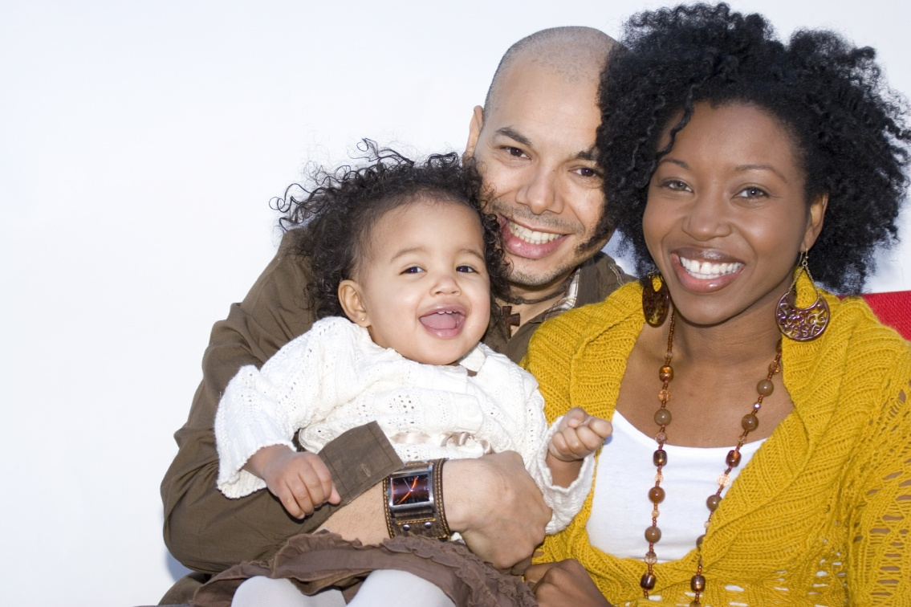
Social Institutions
Family.
Education.
Religion.
Government.
Business.
These institutions function to reinforce cultural norms.

Slide 4
Society, Culture, and Global Consumer Culture
Culture—ways of living, built up by a group of human beings, that are transmitted from one generation to another.
Culture has both conscious and unconscious values, ideas, attitudes, and symbols.
Culture is both physical (clothing and tools) and nonphysical (religion, attitudes, beliefs, and values).
Notes:
This slide introduces the different aspects of culture. Culture is acted out in social institutions or society. The goal of this slide is to help the student see that culture has a number factors affecting it.

Slide 5
Material and Nonmaterial Culture
Subjective or abstract culture
Religion
Perceptions
Attitudes
Beliefs
Values
Physical component or physical culture
Clothing
Tools
Decorative art
Body beautification
Homes
Notes:
Material and nonmaterial elements of culture are interrelated. Cultural universals include athletic sports, body adornment, cooking, courtship, dancing, decorative art, education, ethics, etiquette, family feasting, food taboos, language, marriage, mealtime, medicine, mourning, music, property rights, religious rituals,residents rules, status differentiation, and trade.

Slide 6
Global consumer cultures are emerging:
Persons who share meaningful sets of consumption-related symbols.
Pub culture, coffee culture, fast-food culture, credit card culture.
Primarily the product of a technologically interconnected world:
Internet.
Satellite TV.
Mobile phones.
Notes:
Because of technologies such as satellite TV, Internet, cell phones, and other communication channels, marketers have begun to see the emergence of the global consumer. The hallmark of this culture is consumption. As the world becomes more interconnected, and as cultural imagery continues to freely flow across national borders, it can be expected that this culture will grow. It can be exploited by global consumer culture positioning (GCCP) as discussed in chapter 7.

Slide 7
Attitudes, Beliefs, and Values
Attitudes—learned tendency to respond in a consistent way to a given object or entity.
Belief—an organised pattern of knowledge that an individual holds to be true about the world.
Value—enduring belief or feeling that a specific mode of conduct is personally or socially preferable to another mode of conduct.
Notes:
By accepting Hofstede’s definition of culture (the collective programming of the mind), it would make sense to learn about culture by studying the attitudes, beliefs, and values shared by a specific group of people. Values represent the deepest level of a culture and are shared by the majority of members. Within any culture, there are likely to be subcultures, that is, smaller groups of people with their own shared subset of attitudes, beliefs, and values. Subcultures may represent attractive niche marketing opportunities, such as vegetarians.
Example: Japanese values include striving for cooperation, consensus, self-denial, and harmony.
A Japanese belief is that they are unique in the world. Japanese youth believe that the West is an important source of fashion trends. Therefore, many Japanese share a favorable attitude toward American brands.

Slide 8
National Culture
Professor Geert Hofstede conducted one of the most comprehensive studies of how values in the workplace are influenced by culture.
He defines culture as “the collective programming of the mind distinguishing the members of one group or category of people from others”.

Slide 9
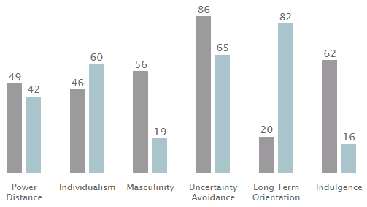
Dimensions of national culture

Slide 10
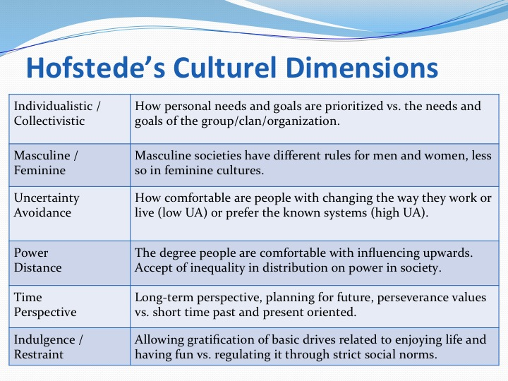

Slide 11
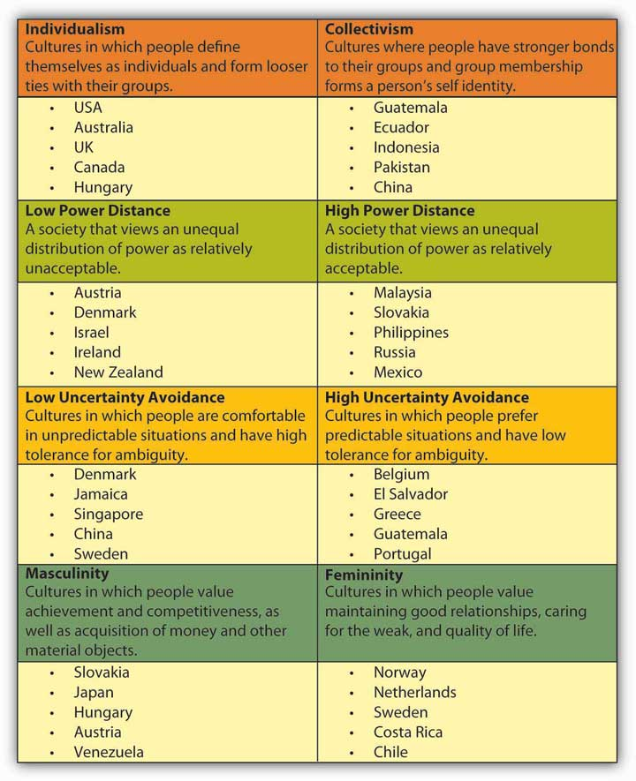

Slide 12
Power Distance Index (PDI)
This dimension expresses the degree to which the less powerful members of a society accept and expect that power is distributed unequally.
Large degree of Power Distance → hierarchical order.
Low Power Distance → distribution of power.

Slide 13
Individualism versus Collectivism (IDV)
Individuals are expected to take care of only themselves and their immediate families.
Collectivism, represents a society in which individuals can expect members of a particular in-group to look after them in exchange for unquestioning loyalty.

Slide 14
Masculinity versus Femininity (MAS)
Masculinity means:
achievement,
assertiveness
material rewards for success
competitive.
Femininity, stands for:
cooperation, modesty, caring for the weak and quality of life.

Slide 15
Uncertainty Avoidance Index (UAI)
Whether or not members of a society feel uncomfortable with uncertainty and ambiguity.
Strong UAI means rigid codes of belief and behaviour and intolerant of unorthodox behaviour and ideas.
Weak UAI societies maintain a more relaxed attitude in which practice counts more than principles.

Slide 16
Long Term Orientation versus Short Term Normative Orientation (LTO)
Societies who score low on this dimension, for example, prefer to maintain time-honoured traditions and norms.
Those with a culture which scores high, on the other hand, take a more pragmatic approach: they encourage thrift and efforts in modern education as a way to prepare for the future.

Slide 17
Indulgence versus Restraint (IND)
Indulgence stands for a society that allows relatively free gratification of basic and natural human drives related to enjoying life and having fun.
Restraint stands for a society that suppresses gratification of needs and regulates it by means of strict social norms.

Slide 18
Religion
Religion is one important source of society’s beliefs, attitudes, and values. The world’s major religions include: Buddhism, Hinduism, Islam, Judaism, and Christianity.

Slide 19
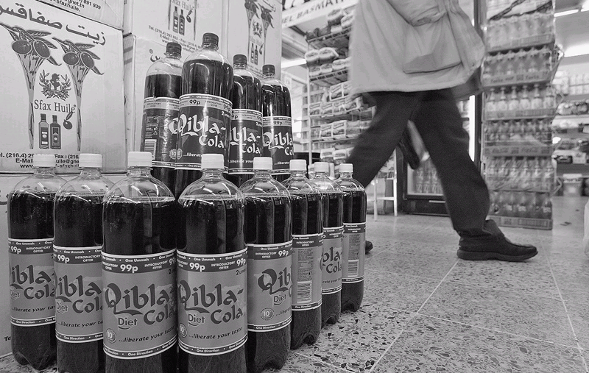
Quibla Cola Products
Notes:
Tunisian–born Tawfik Mathlouthi launched the Mecca Cola brand as an alternative to Coca-Cola for Muslims living in the United Kingdom and France. The name is both an intentional reference to the holy city of Islam as well as an ironic swipe at Coca-Cola, which the founder calls “the Mecca of capitalism.” London’s Sunday Times calls the brand “the drink now seen as politically preferable to Pepsi or Coke.”
Qibla Cola was launched in 2003; company executives hope to position Qibla as an alternative to mainstream American brands. As one executive noted, “We want to show that you can develop a brand that is global, ethical, quality, and commercially viable. We are not trying to do so by being anti-American but by being anti-injustice.” As of mid-2004, Qibla Cola was available in the United Kingdom, the Netherlands, Norway, Canada, and Pakistan.

Slide 20
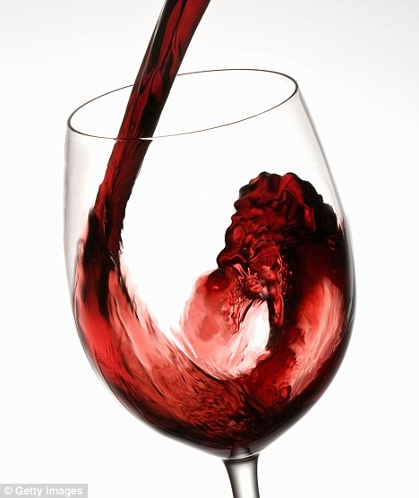
Aesthetics
The sense of what is beautiful and what is not beautiful.
What represents good taste as opposed to tastelessness or even obscenity.
Visual—embodied in the colour or shape of a product, label, or package.
Styles—various degrees of complexity, for example, are perceived differently around the world.
Notes:
Aesthetic elements that are seen as attractive in one country may be viewed differently in another.

Slide 21
Aesthetics and Colour
Red–associated with blood, wine-making, activity, heat, and vibrancy in many countries but is poorly received in some African countries.
White–identified with purity and cleanliness in the West, with death in parts of Asia.
Gray–means inexpensive in Japan and China, but high quality and expensive in the U.S.
Notes:
Some colors may be used in all countries, i.e., Caterpillar yellow, Marlboro’s red chevron, Bluetooth, and JetBlue. Colors may need to be adapted according to local cultural preferences.
Soft drink labels and color associated with good taste: Chinese associate brown. South Koreans and Japanese associate yellow. Americans associate red.

Slide 22
Some colours may be used in all countries, i.e., Caterpillar yellow, Marlboro’s red chevron, Bluetooth, and JetBlue.
Soft drink labels are colour associated with good taste: Chinese associate brown, South Koreans and Japanese associate yellow. Americans associate red.

Slide 23
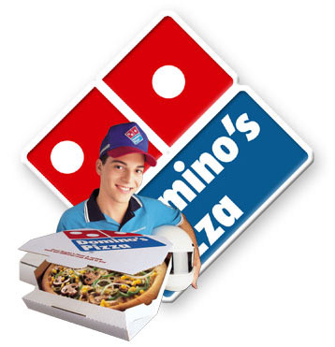
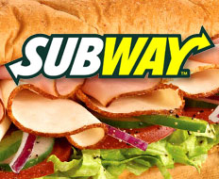
Dietary Preferences
Domino’s Pizza pulled out of Italy because its products were seen as “too American” with bold tomato sauce and heavy toppings.
Subway had to “educate” Indians about the benefits of sandwiches because they do not normally eat bread.
Notes:
Despite local preferences, there is evidence that global dietary preferences are converging. When time-pressed families do not have time to prepare meals, fast food becomes more popular. Young people experiment with different foods. Global tourism has exposed people to pizza, pasta, and other ethic foods. Shorter work hours and tigher budgets are forcing workers to find a place to grab a quick, cheap bite before returning to work.
Due to the backlash to fast food in France, especially le Big Mac, the French National Council of Culinary Arts designed a course on French cuisine and “good taste” for elementary students. The director of the council, Alexandre Lazareff, warns that France’s haute cuisine is under attack by globalization of taste. The French have a new buzzword, le fooding, to express the notion that the nation’s passion for food goes beyond mere gastronomy: “To eat with feeling in France is to eat with your head and your spirit, with your nose, your eyes, and your ears, not simply your palate. Le fooding seeks to give witness to the modernity and new reality of drinking and eating in the 21st century. Everything is fooding so long as audacity, sense, and the senses mix.”

Slide 24
Language and Communication
Speaking English around the globe
There are more people who speak English as a foreign language than native speakers.
85% of European teens study English.
Sony, Nokia, require managers to speak English.
Nonverbal communication
Westerners tend to be verbal, Asians value nonverbal communication.
In Japan, bowing has many distinctions.
In the Middle east, Westerners should not show the soles of shoes or pass documents with the left hand.
Notes:
Westerners must pay close attention not only to what they hear but also what they see when conducting business in other countries.

Slide 25
Self-Reference Criterion and Perception
Unconscious reference to one’s own cultural values; creates cultural myopia
How to reduce cultural myopia
Define the problem or goal in terms of home-country cultural traits
Define the problem in terms of host-country cultural traits; make no value judgments
Isolate the SRC influence and examine it
Redefine the problem without the SRC influence and solve for the host-country situation
Notes:
The lesson that the SRC teaches is that a vital, critical skill of the global marketer is unbiased perception, the ability to see what is so in a culture. Although this skill is as valuable at home as it is abroad, it is critical to the global marketer because of the widespread tendency toward ethnocentrism and use of the self-reference criterion. The SRC can be a powerful negative force in global business, and forgetting to check for it can lead to misunderstanding and failure.
How might the European Disneyland been different if Disney executives had used the four-step approach?
Step 1. Disney executives believe there is virtually unlimited demand for American cultural exports around the world. Evidence includes the success of McDonald's, Coca-Cola, Hollywood movies, and American rock music. Disney has a stellar track record in exporting its American management system and business style. Tokyo Disneyland, a virtual carbon copy of the park in Anaheim, California, has been a runaway success. Disney policies prohibit sale or consumption of alcohol inside its theme parks.
Step 2. Europeans in general and the French in particular are sensitive about American cultural imperialism. Consuming wine with the midday meal is a long-established custom. Europeans have their own real castles, and many popular Disney characters come from European folk tales.
Step 3. The significant differences revealed by comparing the findings in steps 1 and 2 suggest strongly that the needs upon which the American and Japanese Disney theme parks were based did not exist in France. A modification of this design was needed for European success.
Step 4. This would require the design of a theme park that is more in keeping with French and European cultural norms, and thus allow the French to put their own identity on the park.

Slide 26
How might the European Disneyland been different if Disney executives had used the four-step approach?
Step 1. Disney executives believe there is virtually unlimited demand for American cultural exports around the world. Evidence includes the success of McDonald's, Coca-Cola, Hollywood movies, and American rock music.
Disney has a stellar track record in exporting its American management system and business style. Tokyo Disneyland, a virtual carbon copy of the park in California, has been a success.

Slide 27
Step 2. Europeans in general and the French in particular are sensitive about American cultural imperialism. Europeans have their own real castles, and many popular Disney characters come from European folk tales.
Step 3. The significant differences revealed by comparing the findings in steps 1 and 2 suggest strongly that the needs upon which the American and Japanese Disney theme parks were based did not exist in France. A modification of this design was needed for European success.
Step 4. This would require the design of a theme park that is more in keeping with French and European cultural norms, and thus allow the French to put their own identity on the park.

